Slide 1
GENERATION OF COMPUTERS

Slide 2
GENERATION
‘Its all about people born and living about the same age and time.’

Slide 3
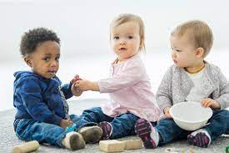
HUMAN GENERATION
Toddlers (2years)

Slide 4
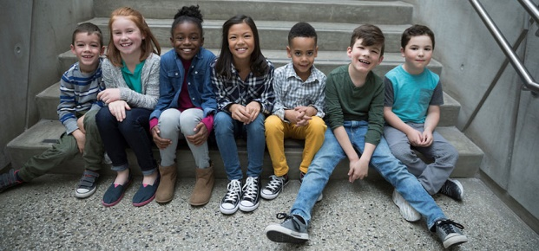
HUMAN GENERATION
Children (10yrs)

Slide 5

HUMAN GENERATION
Adults (18+ years)

Slide 6
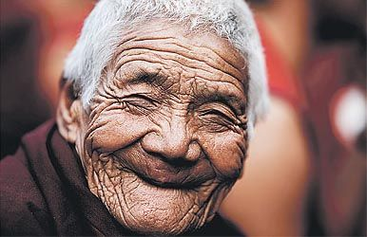
HUMAN GENERATION
Old Aged (70 + Years)

Slide 7
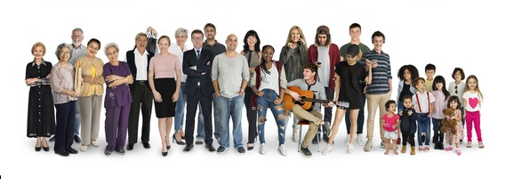
HUMAN GENERATION
Generation takes lifespan of 20 to 30yrs

Slide 8
COMPUTER GENERATIONS
1ST GENERATION
2ND GENERATION
3RD GENERATION
4TH GENERATION
5TH GENERATION

Slide 9
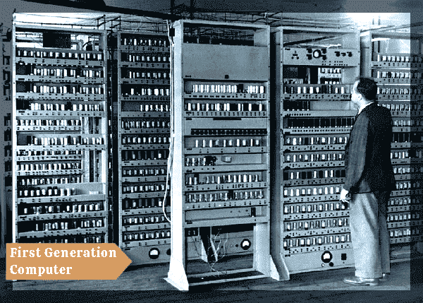
1ST GENERATION COMPUTER (1940s – 1950s)

Slide 10
1ST GENERATION COMPUTER
It used vacuum tube as it main electronic component.
Programming language was only used to run this kin of computer.

Slide 11
1ST GENERATION COMPUTER
It consumes lot of electric power and generate lot of heat.
It was large in size and slow in speed of processing data.

